Slide 1

Chapter 9
Intruders and Viruses
Henric Johnson
Blekinge Institute of Technology, Sweden
http://www.its.bth.se/staff/hjo/
henric.johnson@bth.se

Slide 2
Outline
Intruders
  Intrusion Techniques
  Password Protection
  Password Selection Strategies
  Intrusion Detection
Viruses and Related Threats
  Malicious Programs
  The Nature of Viruses
  Antivirus Approaches
  Advanced Antivirus Techniques
Recommended Reading and WEB Sites

Slide 3
Intruders
Three classes of intruders (hackers or crackers):
  Masquerader
  Misfeasor
  Clandestine user

Slide 4
Intrusion Techniques
System maintain a file that associates a password with each authorized user.
Password file can be protected with:
  One-way encryption
  Access Control

Slide 5
Intrusion Techniques
Techniques for guessing passwords:
  Try default passwords.
  Try all short words, 1 to 3 characters long.
  Try all the words in an electronic dictionary(60,000).
  Collect information about the user’s hobbies, family names, birthday, etc.
  Try user’s phone number, social security number, street address, etc.
  Try all license plate numbers (MUP103).
  Use a Trojan horse
  Tap the line between a remote user and the host system.
Prevention: Enforce good password selection (Ij4Gf4Se%f#)

Slide 6
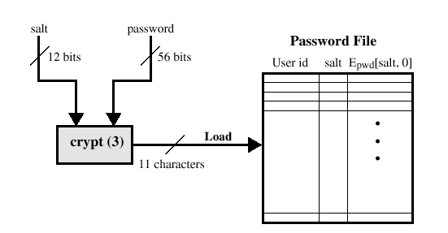
UNIX Password Scheme
Loading a new password

Slide 7
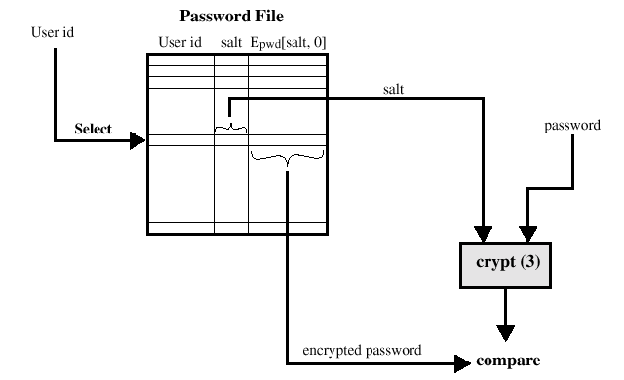
UNIX Password Scheme
Verifying a password file

Slide 8
Storing UNIX Passwords
UNIX passwords were kept in in a publicly readable file, etc/passwords.
Now they are kept in a “shadow” directory and only visible by “root”.

Slide 9
”Salt”
The salt serves three purposes:
  Prevents duplicate passwords.
  Effectively increases the length of the password.
  Prevents the use of hardware implementations of DES

Slide 10
Password Selecting Strategies
User ducation
Computer-generated passwords
Reactive password checking
Proactive password checking

Slide 11
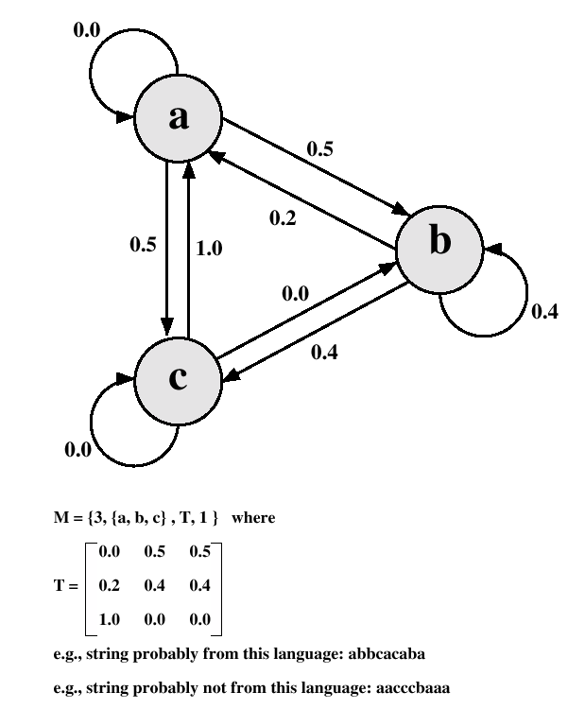
Markov Model

Slide 12

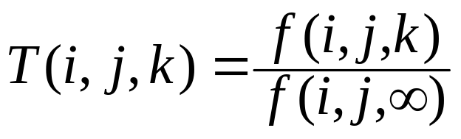
Transition Matrix
Determine the frequency matrix f, where f(i,j,k) is the number of occurrences of the trigram consisting of the ith, jth and kth character.
For each bigram ij, calculate f(i,j, ) as the total number of trigrams beginning with ij.
Compute the entries of T as follows:

Slide 13
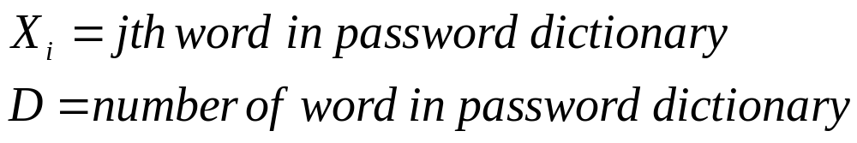
Spafford (Bloom Filter)
where
The following procedure is then applied to the dictionary:
A hash table of N bits is definied, with all bits initially set to 0.
For each password, its k hash values are calculated, and the responding bits in the hash table are set to 1

Slide 14
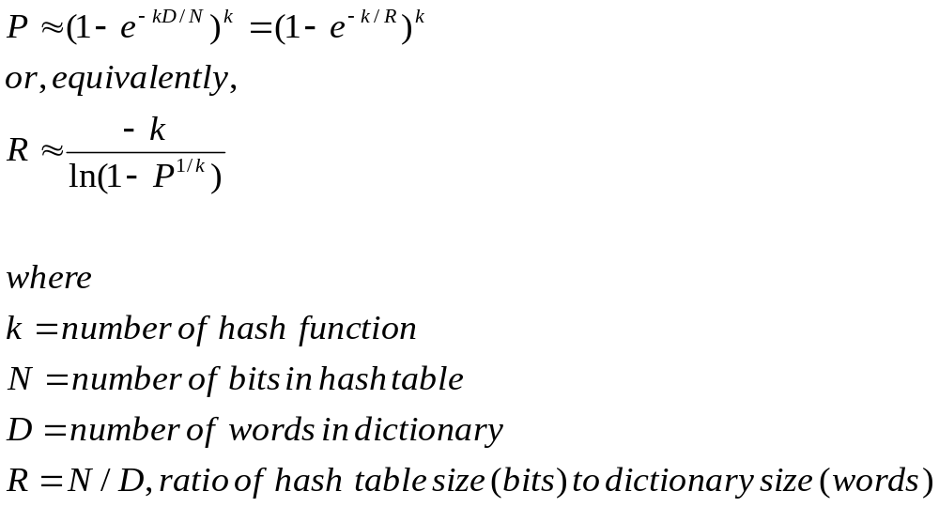
Spafford (Bloom Filter)
Design the hash scheme to minimize false positive.
Probability of false positive:

Slide 15
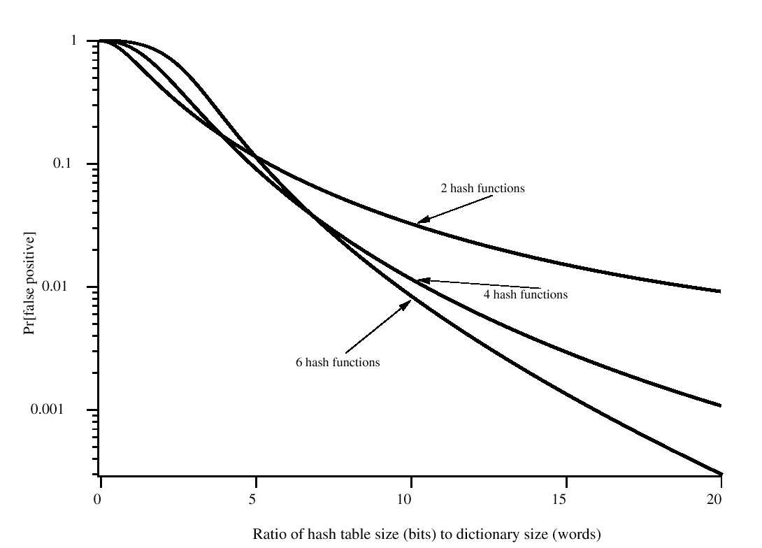
Performance of Bloom Filter

Slide 16
The Stages of a Network Intrusion
1. Scan the network to:
• locate which IP addresses are in use,
• what operating system is in use,
• what TCP or UDP ports are “open” (being listened to by Servers).
2. Run “Exploit” scripts against open ports
3. Get access to Shell program which is “suid” (has “root” privileges).
4. Download from Hacker Web site special versions of systems files that will let Cracker have free access in the future without his cpu time or disk storage space being noticed by auditing programs.
5. Use IRC (Internet Relay Chat) to invite friends to the feast.

Slide 17
Intusion Detection
The intruder can be identified and ejected from the system.
An effective intrusion detection can prevent intrusions.
Intrusion detection enables the collection of information about intrusion techniques that can be used to strengthen the intrusion prevention facility.

Slide 18
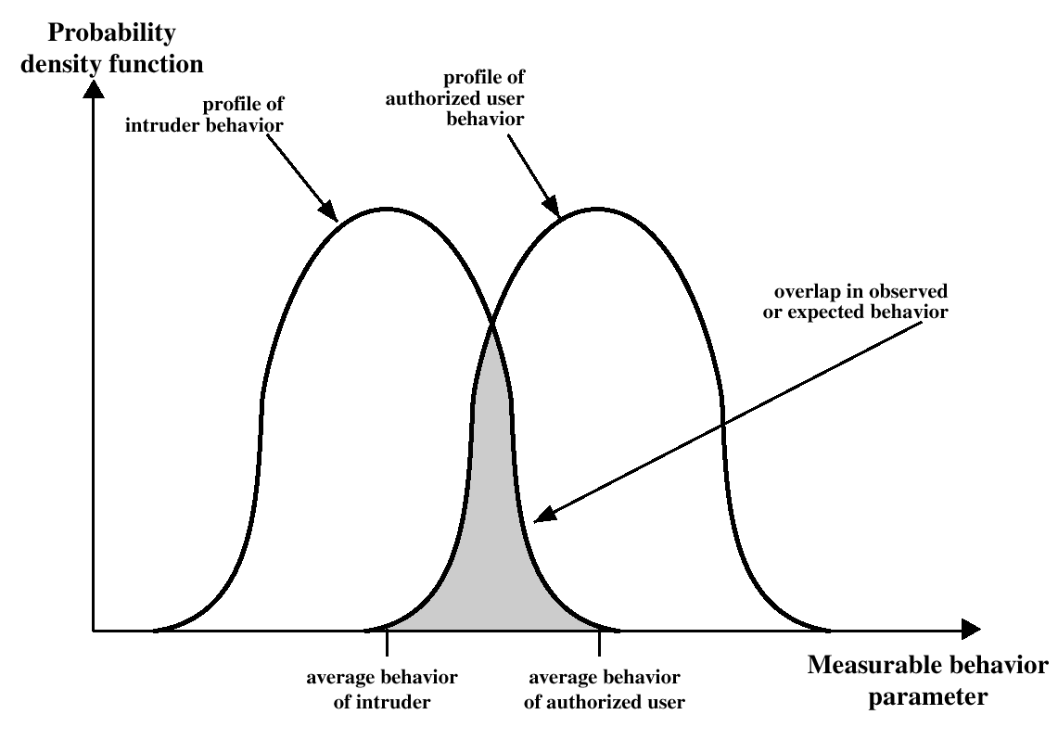
Profiles of Behavior of Intruders and Authorized Users

Slide 19
Intrusion Detection
Statistical anomaly detection
  Treshold detection
  Profile based
Rule based detection
  Anomaly detection
  Penetration identidication

Slide 20
Measures used for Intrusion Detection
Login frequency by day and time.
Frequency of login at different locations.
Time since last login.
Password failures at login.
Execution frequency.
Execution denials.
Read, write, create, delete frequency.
Failure count for read, write, create and delete.

Slide 21
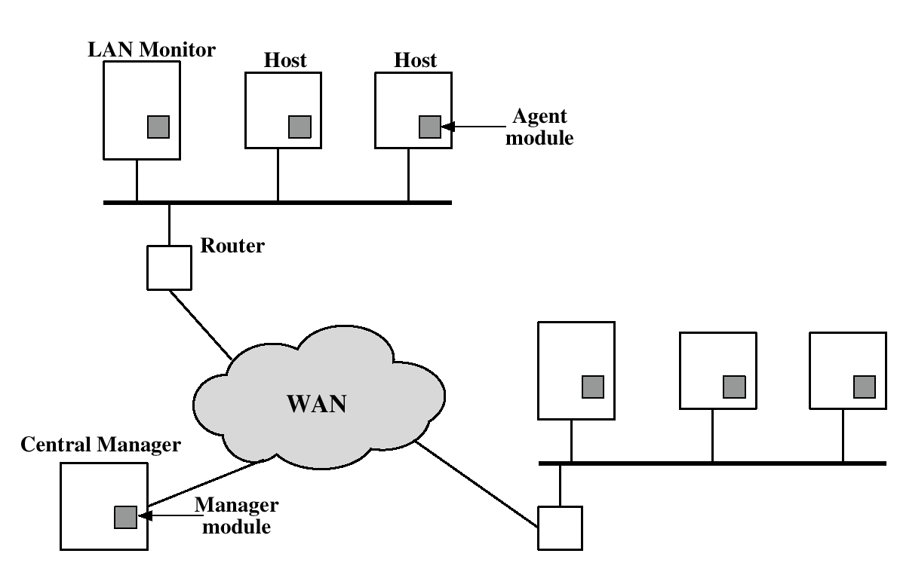
Distributed Intrusion Detection
Developed at University of California at Davis

Slide 22
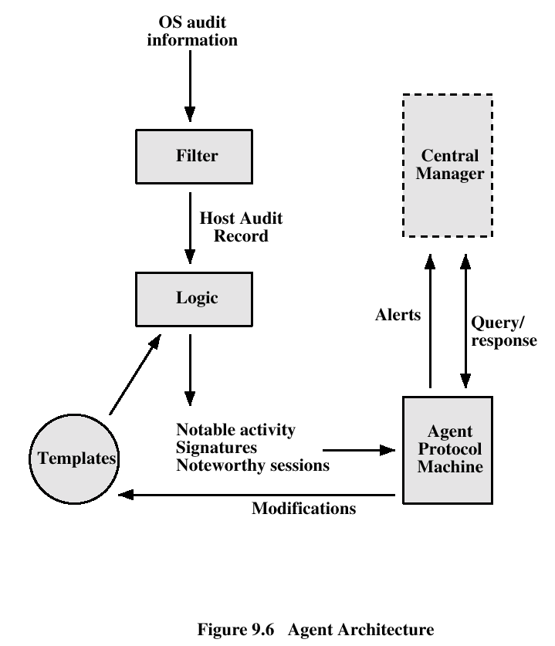
Distributed Intrusion Detection

Slide 23
Viruses and ”Malicious Programs”
Computer “Viruses” and related programs have the ability to replicate themselves on an ever increasing number of computers. They originally spread by people sharing floppy disks. Now they spread primarily over the Internet (a “Worm”).
Other “Malicious Programs” may be installed by hand on a single machine. They may also be built into widely distributed commercial software packages. These are very hard to detect before the payload activates (Trojan Horses, Trap Doors, and Logic Bombs).

Slide 24
Taxanomy of Malicious Programs
Malicious Programs
Need Host Program
Independent
Trapdoors
Logic Bombs
Trojan
Horses
Viruses
Bacteria
Worms

Slide 25
Definitions
Virus - code that copies itself into other programs.
A “Bacteria” replicates until it fills all disk space, or CPU cycles.
Payload - harmful things the malicious program does, after it has had time to spread.
Worm - a program that replicates itself across the network (usually riding on email messages or attached documents (e.g., macro viruses).

Slide 26
Definitions
Trojan Horse - instructions in an otherwise good program that cause bad things to happen (sending your data or password to an attacker over the net).
Logic Bomb - malicious code that activates on an event (e.g., date).
Trap Door (or Back Door) - undocumented entry point written into code for debugging that can allow unwanted users.
Easter Egg - extraneous code that does something “cool.” A way for programmers to show that they control the product.

Slide 27
Virus Phases
Dormant phase - the virus is idle
Propagation phase - the virus places an identical copy of itself into other programs
Triggering phase – the virus is activated to perform the function for which it was intended
Execution phase – the function is performed

Slide 28
Virus Protection
Have a well-known virus protection program, configured to
scan disks and downloads automatically for known viruses.
Do not execute programs (or "macro's") from unknown
sources (e.g., PS files, Hypercard files, MS Office documents,
Avoid the most common operating systems and email
programs, if possible.

Slide 29
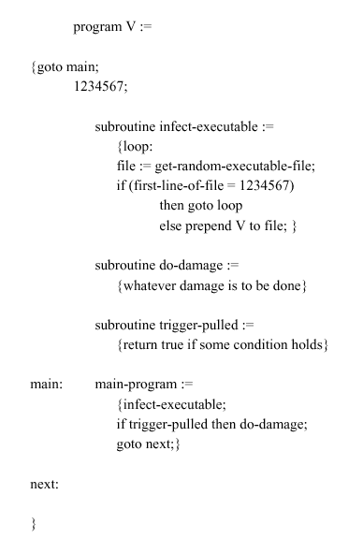
Virus Structure

Slide 30
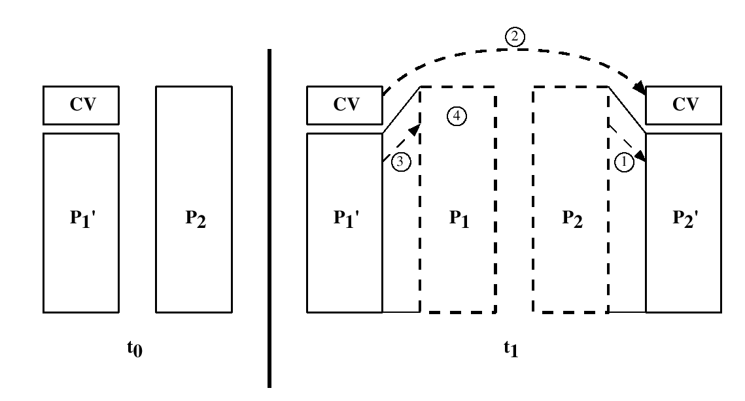
A Compression Virus

Slide 31
Types of Viruses
Parasitic Virus - attaches itself to executable files as part of their code. Runs whenever the host program runs.
Memory-resident Virus - Lodges in main memory as part of the residual operating system.
Boot Sector Virus - infects the boot sector of a disk, and spreads when the operating system boots up (original DOS viruses).
Stealth Virus - explicitly designed to hide from Virus Scanning programs.
Polymorphic Virus - mutates with every new host to prevent signature detection.

Slide 32
Macro Viruses
Microsoft Office applications allow “macros” to be part of the document. The macro could run whenever the document is opened, or when a certain command is selected (Save File).
Platform independent.
Infect documents, delete files, generate email and edit letters.

Slide 33
Antivirus Approaches
1st Generation, Scanners: searched files for any of a library of known virus “signatures.” Checked executable files for length changes.
2nd Generation, Heuristic Scanners: looks for more general signs than specific signatures (code segments common to many viruses). Checked files for checksum or hash changes.
3rd Generation, Activity Traps: stay resident in memory and look for certain patterns of software behavior (e.g., scanning files).
4th Generation, Full Featured: combine the best of the techniques above.

Slide 34
Advanced Antivirus Techniques
Generic Decryption (GD)
  CPU Emulator
  Virus Signature Scanner
  Emulation Control Module
For how long should a GD scanner run each interpretation?

Slide 35
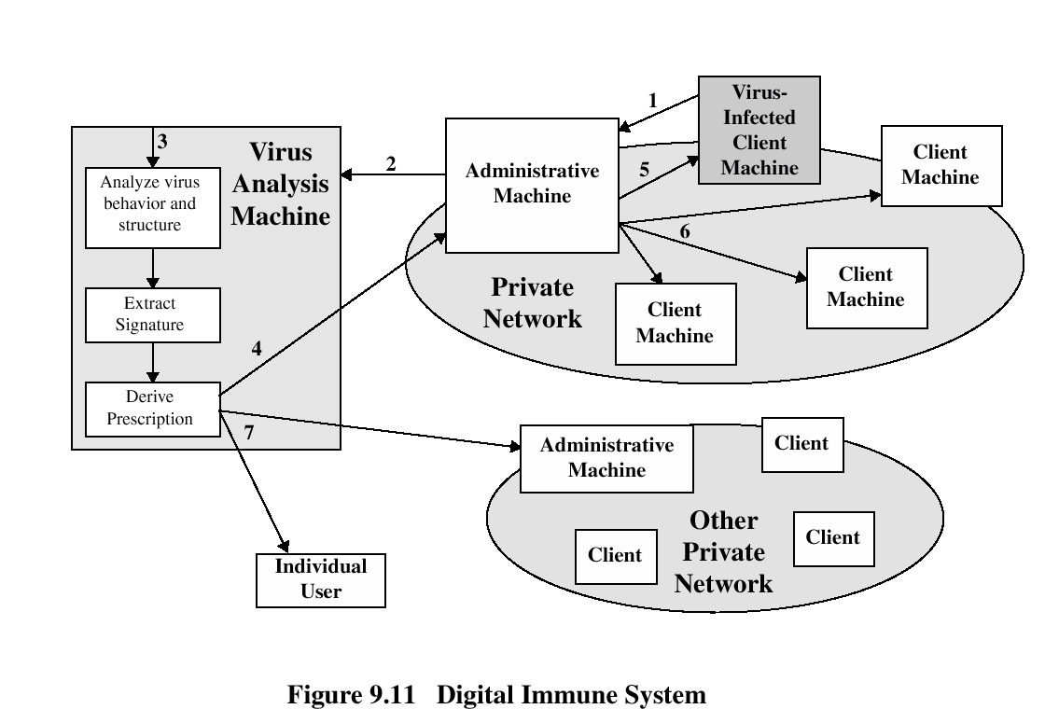
Advanced Antivirus Techniques

Slide 36
Recommended Reading and WEB Sites
Denning, P. Computers Under Attack: Intruders, Worms, and Viruses. Addison-Wesley, 1990
CERT Coordination Center (WEB Site)
AntiVirus Online (IBM’s site)

